Slide 1
COMP 4290
Week 2 - Monday

Slide 2
Last time
What did we talk about last time?
Attackers
Controls

Slide 3
Questions?

Slide 4
Assignment 1

Slide 5
Project 1

Slide 6
Security tidbit of the day
Text computer analysis can be done to compare writing styles
  Such an analysis confirmed that Robert Galbraith was actually J. K. Rowling
  It's called forensic linguistics
Can your coding style be analyzed to see if you are the author of some source code?
  Sure! Programmers have quirks that make it possible to guess that two programs were written by the same person

Slide 7
Security tidbit continued
But what about the binaries of your code?
  Yes! Even the compiled version of the code is distinctive enough
  Recent research was able to de-anonymize code from 100 programmers with 96% accuracy
  They de-anonymized 600 programmers with 83% accuracy
  They were even able to de-anonymize optimized code from 100 programmers with 89% accuracy
  Don't forget that compilers do crazy stuff to code!
So, if you write a virus, it might one day be possible for people to know it's you just from the executable
Read the paper:
  https://faculty.washington.edu/aylin/papers/caliskan_when.pdf

Slide 8
Authentication

Slide 9
Authentication vs. identification
Identification is asserting who someone is
Your identity includes your name, your bank account numbers, your e-mail addresses, TikTok handle, and anything else linked to you
Identification is not as strong as authentication, which requires proof

Slide 10
Definition of authentication
Authentication is proving an identity
  Example: Bill Gates (external entity) is a registered user whose identity on this system is gatesw (identity of system subject)
The external identity must provide information to authenticate based on
  What the entity knows (passwords)
  What the entity has (security badge)
  What the entity is (fingerprints or voice ID)

Slide 11
Passwords

Slide 12
Passwords
Passwords are one of the most common forms of authentication mechanisms based on what the entity knows
The password represents authentication information that the user must know
The system keeps complementation information that can be used to check the password
Real systems generally do not store passwords in the clear but store hashes of them
Unix chooses one of 4,096 different hash functions, hashes the password into an 11-character string, and then prepends 2 characters specifying which hash function was used

Slide 13
Difficulties using passwords
Use
  Supplying passwords for each access is tedious
Disclosure
  If someone else learns a password, it provides no protection and has to be changed, requiring all users to get a new password
Revocation
  Changing the password also requires all users to get a new password
Loss
  Secure systems usually cannot tell you what your password was, requiring you to choose a new one

Slide 14
Attacking a password system
A dictionary attack is an attack based on guessing the password from trial and error
  A dictionary attack can work on the complementary information (hashes of passwords)
  If this information is unavailable, a dictionary attack can directly attack the authentication functions (literally trying to log in repeatedly)
Let P be the probability that an attacker guesses the password over a certain span of time
Let G be the number of guesses that can be made per unit time
Let T be the number of time units of guessing
Let N be the number of possible passwords
Then,

Slide 15
Random passwords
One way of protecting against attacks is by making an attacker search the largest possible number of passwords
You can maximize this time by making all passwords in the set of possible passwords equally likely
To do this, you use a strong source of randomness to generate your password
Advantages and disadvantages?

Slide 16
Pronounceable passwords
Because it is difficult to memorize truly random passwords, randomly generating pronounceable passwords is sometimes used instead
A pronounceable password is one made up of a string of random syllables that can be pronounced together
  helgoret
  juttelon
It is not difficult to write a computer program to produce a string of pronounceable phonemes
Advantages and disadvantages?

Slide 17
User selection of passwords
Instead of either of the previous methods for randomly generating passwords, most systems allow users to pick their own passwords
Unfortunately, users are notoriously bad at picking passwords
  Everyone picks "babygirl" or, worse, "password"
Proactive password checkers allow users to pick passwords but reject them if they violate certain conditions

Slide 18
Easy to guess passwords
Passwords based on account names
Passwords based on user names
Passwords based on computer names
Dictionary words (and reversed versions)
Dictionary words with some or all letters capitalized (and reversed versions)
Dictionary words with some letters turned into control characters or 1337 substitutions
Conjugations of dictionary words
Keyboard patterns
Passwords shorter than 6 characters
Passwords containing only digits
Passwords containing just letters, letters and numbers, or letters and punctuation
Passwords that look like license plate numbers
Acronyms
Past passwords
Concatenations of dictionary words
Dictionary words with digits, punctuation, or spaces preceding or following
Dictionary words with all vowels deleted
Dictionary words with white spaces deleted
Passwords too similar to the previous password

Slide 19
Traditional advice on good passwords
Researchers suggest a password should have at least one digit, one letter, one punctuation symbol, and (ideally) one control character (not possible in many environments)
Relatively strong passwords can be generated by taking an unusual phrase or line of a poem and taking (say) the third letter out of each word, leaving in punctuation, and capitalizing some letters according to a rule

Slide 20
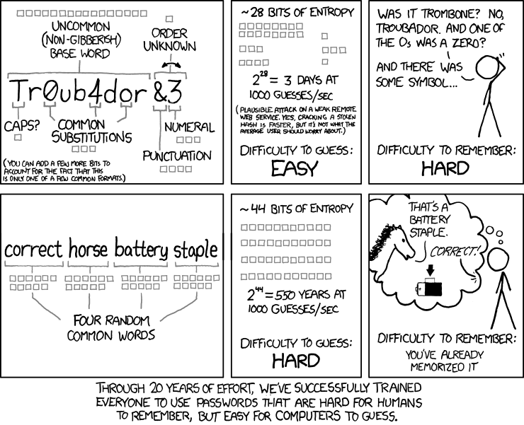
XKCD fights back
The author of XKCD makes an argument that longer passwords using only simple dictionary words are better

Slide 21
XKCD isn't enough
This comic was popular enough that it affected many user's habits
Unfortunately, using only four words isn't enough: try six
The biggest problem is that you should never think up the words yourself
  Humans are pretty terrible at being random
Instead, they should be pulled randomly from a large dictionary
Here are some thoughts about passwords by someone who cracked an XKCD-style password of a systems administrator: https://www.unix-ninja.com/p/your_xkcd_passwords_are_pwned

Slide 22
Proactive password checker criteria
To be a solid proactive password checker, research suggests it must meet certain criteria:
  It must always be used
  It must be able to reject easily guessed passwords
  It must discriminate on a per-user basis (checking family names and birthdays, etc.)
  It must discriminate on a per-site basis (no commonly used site acronyms)
  It should have a pattern matching facility to catch bad passwords like "aaaaa"
  It needs the ability to execute other programs as subroutines
  It should be easy to set up

Slide 23
Salting
Some attackers are looking for any password instead of trying to find a specific password
If they have access to the file with the hashes of passwords, they have much less searching to do if the total number of accounts is large (some hash will match, even if the password doesn't)
For this case, salting is used
Salting adds data to the password in stored form so that an attacker cannot immediately recognize the password
In Unix, this is a random choice of 4,096 different hashing functions (the specific choice is recorded with the password)
Other systems can simply add random bits to the end of the password before hashing (which can all be tried at authentication time)
The book gives an example where the user name is combined with the password before hashing
Salting has little or no impact on an attack against a single password

Slide 24
Attacking authentication functions
In many cases, attackers do not have access to the complementation functions (the raw hash values or the hash functions)
Instead, they must attack the authentication functions themselves
In these situations, authentication functions can be protected by one of several common techniques

Slide 25
Defending authentication functions
Backoff
  Force the user to wait longer and longer between failed authentication techniques
  Exponential backoff means that the first time waits 1 second before allowing a user to log in, the second waits 2 seconds, the third waits 4 seconds, etc.
Disconnection
  If the connection is remote and requires significant time to connect (dialing, VPN, etc.), the system can simply break connection after a number of failed attempts
Disabling
  With n failed attempts, an account is locked until an administrator resets the account
Jailing
  In jailing, the user is allowed to enter a fake system that looks like the real one
  In theory, jailing can be used to learn more about an attacker's goals
  Attractive data (called honeypots) can be made available, tempting the attacker to spend more time on the system (until he can be caught)

Slide 26
Password aging
Password aging is the idea that passwords should be changed in approximately the amount of time it would take to guess them
This concept fuels the requirement that we change our Outlook passwords frequently
In principle, this is a sound security idea
In practice, over-frequent (or unwarned) password expirations cause user discontent and unconstructive behavior (changing passwords minimally or writing new passwords on Post-It notes)
It's more important to have a different password for each site and account
Unless you can remember hundreds of strong passwords, you need a password manager

Slide 27
Challenge Response

Slide 28
Pass Algorithms
Some systems have a special function f a user (or user's system) must know
Thus, the system will give the user a prompt, and the user must respond
Perhaps the system would issue a random value to the user, who must then encrypt it with his secret key and send it back to the user
Perhaps it's just some other way of processing the data
Monkey Island 2: LeChuck's Revenge hand puzzle

Slide 29
Security questions
Security questions represent a kind of challenge and response
However, security questions are often easy to defeat since someone with a little knowledge about you might know or be able to guess the answers
Security experts suggest that you treat security questions as secondary passwords and create strong passwords for them as well

Slide 30
Problems with security questions
Sarah Palin's personal e-mail account was hacked during the 2008 presidential campaign
Her e-mail gov.palin@yahoo.com had previously been publicized in the news
The attacker, 20-year-old college student David Kernell impersonated Palin, claimed to have forgotten the password, and answered her security questions, all widely known facts
  Birth date
  Zip code
  Where she met her husband
He changed the password to popcorn

Slide 31
One-Time Passwords
A one-time password is invalidated as soon as it is used
Thus, an attacker stealing the password can do limited damage
  They can only log in once
  They have to act quickly before the legitimate user logs in first
How do you generate all these passwords?
How do you synchronize the user and the system?

Slide 32
One-time password implementations
RSA SecurIDs change the password every 30 or 60 seconds
The user must be synchronized with the system within a few seconds to keep this practical
Using a secure hash function, we start with a seed value k, then
  h(k) = k₁, h(k₁) = k₂, …, h(k_{n-1}) = k_{n}
Then passwords are in reverse order
  p₁ = k_{n}, p₂ = k_{n-1}, … p_{n-1} = k₂, p_{n} = k₁
Similar systems are used for two-factor authentication apps

Slide 33
Biometrics

Slide 34
Biometrics
Biometrics means identifying humans by their physical and biological characteristics
This technology is often seen in spy and science fiction movies
Although growing more common, it's far from perfect
Like passwords, the actual biometric scans are usually not stored
  Instead specific features are stored for later comparison
Biometrics pose unique privacy concerns because the information collected can reveal health conditions

Slide 35
Fingerprints
Historically, fingerprints are one of the most heavily used forms of biometric identification
  Especially useful for solving crimes
  Even identical twins have different fingerprints
  Fun fact: Koalas have fingerprints so similar to human beings that even experts are fooled
Optical scanners are available
Cheap, capacitive scanners are now even available on many laptops and phones
The image of the fingerprint is usually not stored
Instead, specific, differentiable features are recorded

Slide 36
Voice recognition
Voice recognition systems must be trained on your voice
They can be defeated with recording devices
If you have a cold, it throws off the characteristics of your voice
As a consequence, they are particularly susceptible to both false positives and false negatives

Slide 37

Eye recognition
As the technology matures and hardware becomes cheaper, eye recognition is becoming more common
Iris recognition looks at the patterns of light and dark areas in your iris (the colored part of your eye)
  For simplicity, the image is converted to grayscale for comparison
  Newer iris scanners can make successful identifications at 10 feet away or more, even correcting for glasses!
Retina scans exist but are unpopular
  The retina is the tissue lining the inside of your eye and requires pupil dilation to get an accurate picture, blinding you for several minutes
There are even systems for recognizing the patterns of discolorations on the whites of your eyes

Slide 38
Face recognition
The shape of your face, the distance between your eyes and nose, and other facial features are relatively distinctive
  Although they can be nearly the same for identical twins
Computer vision techniques must be used to locate the face, deal with changes in haircut, glasses, etc.
Participants must have a neutral facial expression or results can be thrown off
The US Department of State uses facial recognition and fingerprinting to document foreigners entering the country
  Although it's for law enforcement, not authentication, the FBI has a database of more than 640 million photos for face recognition
Phones and computers now use this technology commonly

Slide 39
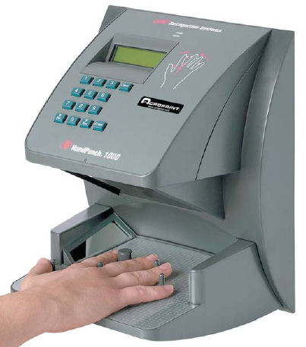
Other biometrics
Hand geometry readers measure the shape of your hand
Keystroke dynamics are the patterns that you use when typing
  Users are quite distinctive, but distractions and injuries can vary patterns a lot
Combinations of different biometrics are sometimes used
DNA sequencing is not (yet) fast enough to be used for authentication
Researchers are finding new biometrics to use

Slide 40
Problems with biometrics
People assume that they are more secure than they are
Attacks:
  Fingerprints can be lifted off a champagne glass
  Voices can be recorded
  Iris recognition can be faked with special contact lenses
Both false positives and false negatives are possible
Disabilities can prevent people from using some kinds of biometrics
It's possible to tamper with transmission from the biometric reader
Biometric characteristics can change
Identical twins sometimes pose a problem
Some people find them intrusive

Slide 41
False positives and false negatives
 | Is the Person Claimed | Is Not the Person Claimed
Test is Positive | a | b
Test is Negative | c | d
Sensitivity is positive results among correct matches
  a / (a + c)
Specificity is negative results among people who are not sought
  d / (b + d)
Accuracy is how often the test is correct
  (a + d) / (a + c + b + d)
Prevalence is how common a condition is
  (a + c) / (a + c + b + d)

Slide 42
Upcoming

Slide 43
Next time…
Finish authentication
Access control
Adam Garantche presents

Slide 44
Reminders
Read Section 2.2
Look at Project 1

